Slide 1
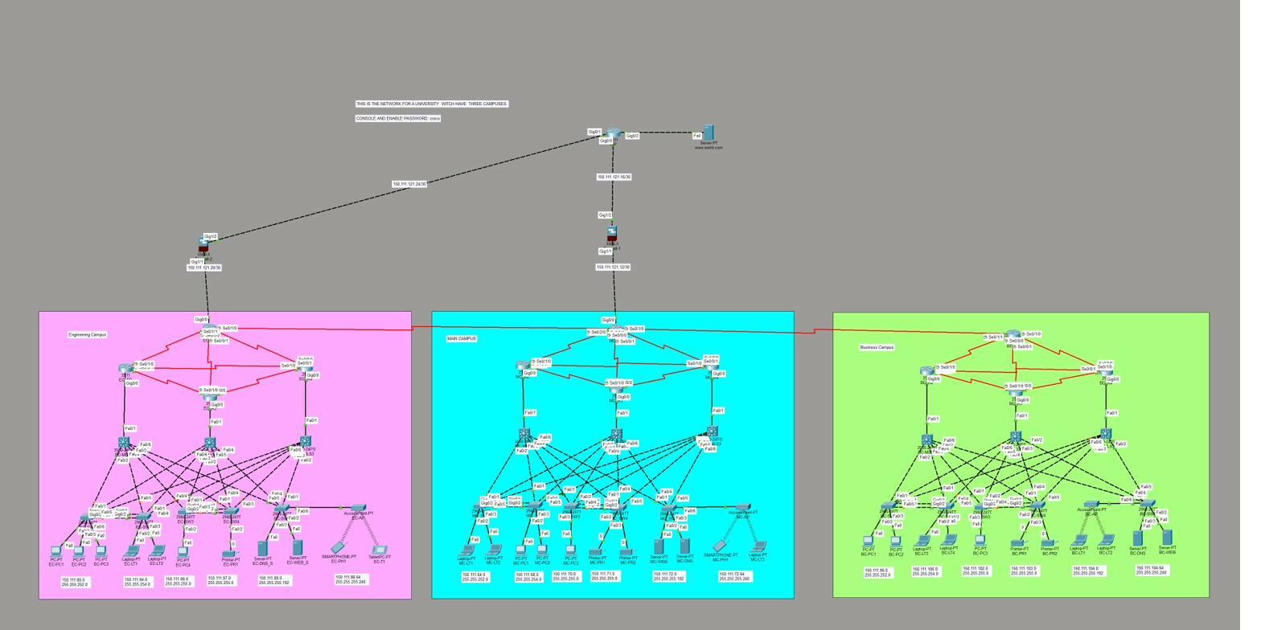
Three-Campus
University Network
Design · Configuration · Documentation
Peter's & Johnson's Tech | Bräutigam Péter · Cséplő János
Cisco Packet Tracer 9.0.0 + VirtualBox | Dombóvár, 2026

Slide 2
Team Members
Bräutigam Péter
Cséplő János
Project Manager & Network Designer
Configuration, Testing & Linux ops
Network architecture design
IP addressing and routing scheme
MAIN-WINSRV01 configuration
Jira project management, sprint planning
Configuration testing, 100+ cases
ENG-LINSRV01 (Debian 13) management
Test catalog and Jira documentation
Git version control
Project Management: Agile / Scrum · Tools: Jira · Git · Discord

Slide 3
Project Overview
Project Goal
Full-mesh topology
Design, configure and test a three-campus university network — reliable, scalable infrastructure with VLAN segmentation, dual-stack IPv4/IPv6 addressing and built-in redundancy.
Every campus directly connected – no single point of failure
VLAN segmentation
Main Campus
6 VLANs per campus – traffic and security logically separated
Main campus – IT and administration
IPv4/IPv6 dual-stack
Engineering Campus
Parallel addressing on every segment – future-proof infrastructure
Engineering labs and research infrastructure
Built-in redundancy
Business Campus
EtherChannel (L2) + OSPF auto-rerouting (L3) – automatic failover
Economics faculty and business administration

Slide 4
Network Topology – Full-Mesh
Full-Mesh Architecture
Every campus is directly interconnected with one another (3 P2P links). If one fails → traffic automatically reroutes through the other path.
Layered Campus Design
Core switch → Distribution → Access
Each layer performs a different task: routing, interconnection, and endpoints.
Devices per Campus
1× ISR Router · 1× ASA Tűzfal · 1× L3 Core Switch
2× Distribution Switch · Access switch-ek · Access Point-ok

Slide 5
Simulation and Server Environment
Cisco Packet Tracer 9.0.0
VirtualBox Servers
MAIN-WINSRV01
Windows Server 2019
IP: 150.111.72.10/26
Domain: campus.local
Active Directory + DNS + DHCP
File & Print Services
GPO Software Deployment
ENG-LINSRV01
Debian 13 Linux
IP: 150.111.72.20/26
Full functional simulation — routing, VLAN, DHCP, wireless,
security configuration all actually runs and is testable
Apache2 HTTP/HTTPS Web Server
Automated backup – rsync + cron (02:00)

Slide 6
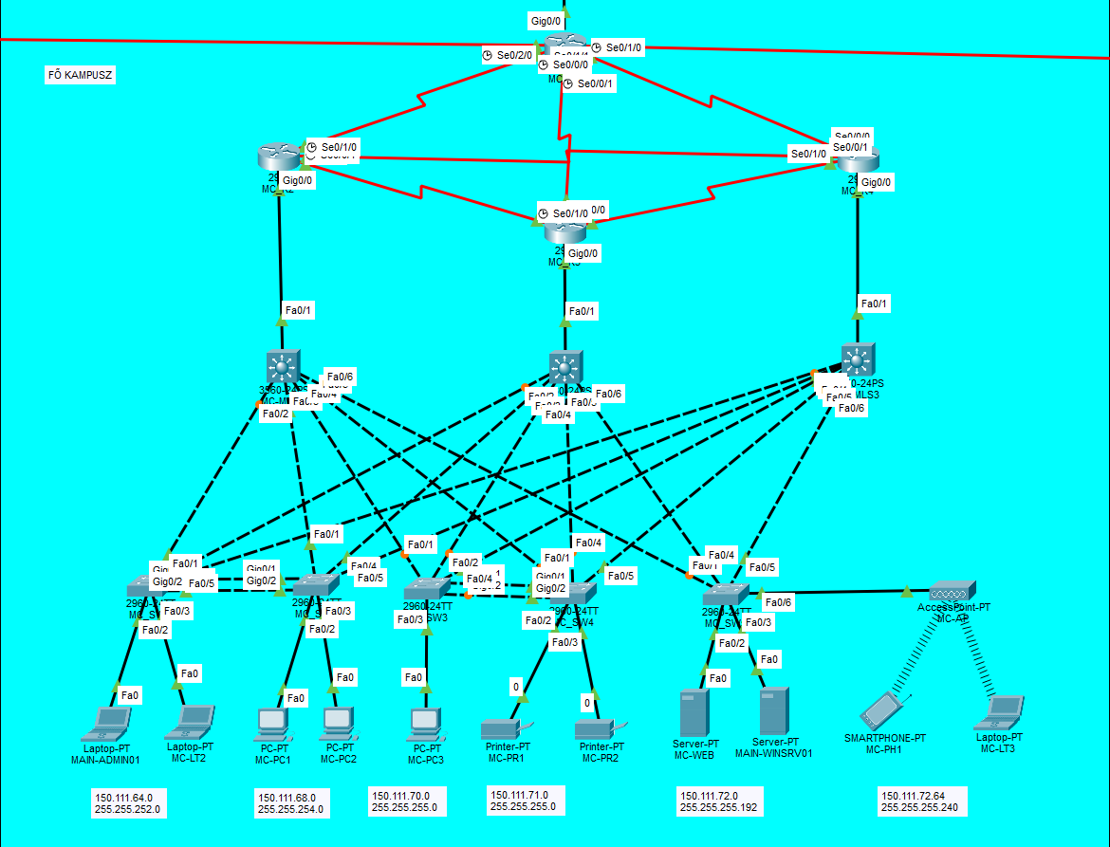
Main Campus
Campus Characteristics
Purpose and Role
Central administration and IT infrastructure.
IP range: 150.111.64.0/19
Servers
MAIN-WINSRV01 (Win Server 2019)
AD, DNS, DHCP, File, Print, GPO
Webszerver (HTTP/HTTPS)
Security
ASA Firewall + NAT/PAT – hiding internal IPs.
VLAN ACL, port security, DHCP snooping.
Routing and Redundancy
OSPF/OSPFv3 · Full-mesh · EtherChannel L2

Slide 7
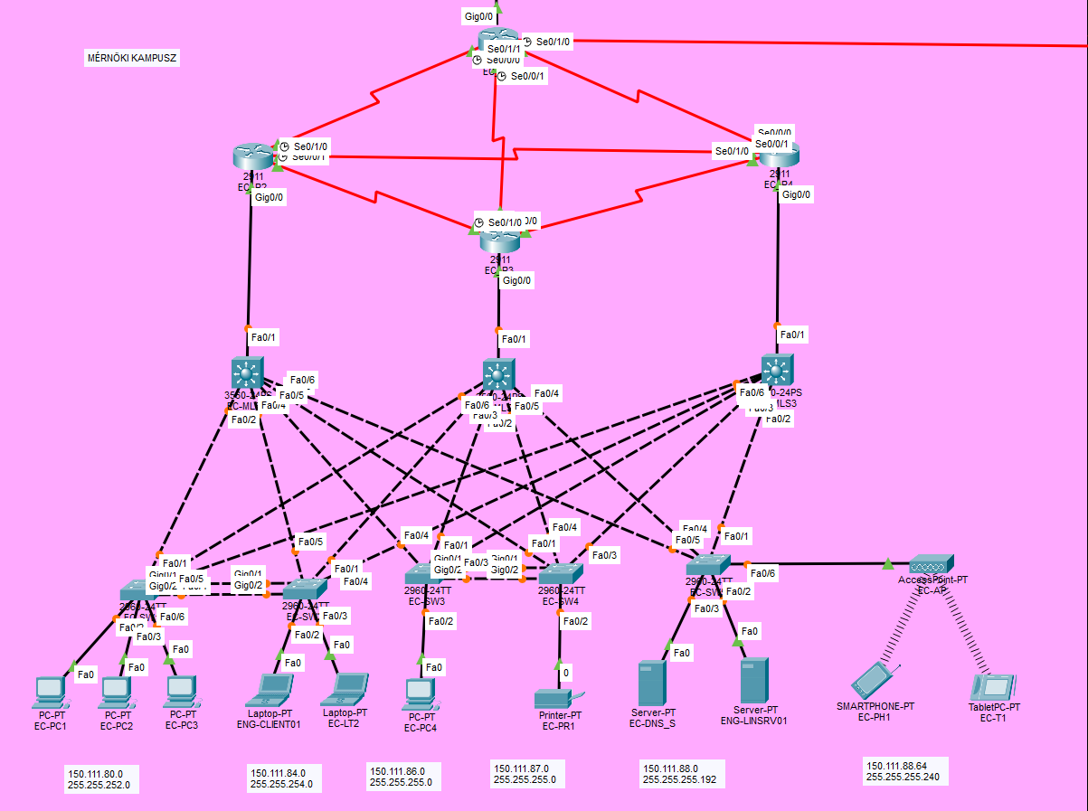
Engineering Campus
Campus Characteristics
Purpose and Role
Engineering labs, research infrastructure.
IP range: 150.111.80.0/20
Servers
ENG-LINSRV01 (Debian 13)
Apache2 web server + rsync backup (02:00)
DNS – local name resolution
Security
ASA Firewall · WPA2-PSK wireless
VLAN ACL · IPSec VPN → Business Campus
Routing and Redundancy
OSPF/OSPFv3 · Full-mesh · Auto-rerouting

Slide 8
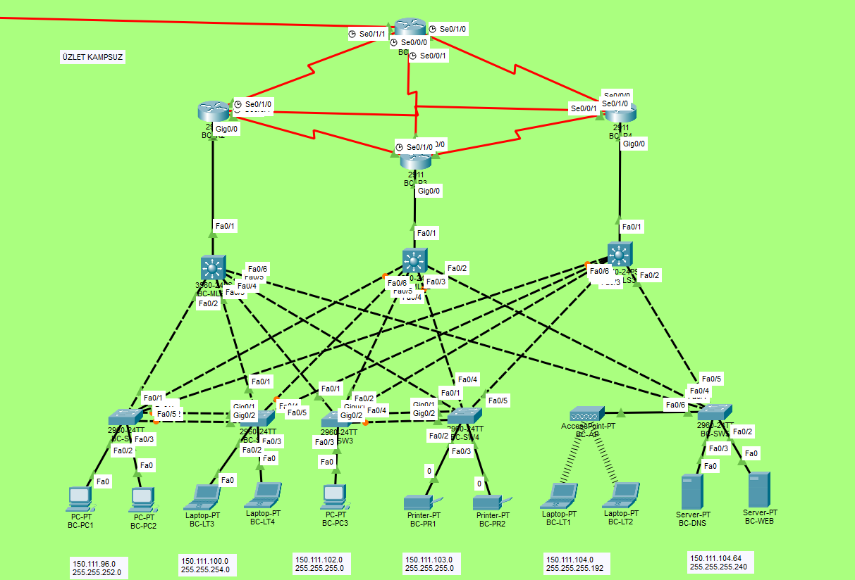
Business Campus
Campus Characteristics
Purpose and Role
Faculty of Economics and business administration
IP range: 150.111.96.0/20
Servers
Webszerver (HTTP/HTTPS) – belső kampusz
DNS – helyi névfeloldás
Security
ASA Firewall · VLAN ACL · Port security
IPSec VPN → Engineering Campus
Routing and Redundancy
OSPF/OSPFv3 · Full-mesh · STP (loop prevention)

Slide 9
VLAN Segmentation – Logical Separation
One physical network – multiple logically separated segments. Students cannot see admin traffic, printers cannot reach servers, and guest WiFi is completely isolated.
VLAN | Név | Subnet | Megjegyzés
10 | Students | /22 (~1000 host) | Largest segment
20 | Faculty/Staff | /23 (~500 host) | Separated administration
30 | Classrooms | /24 (~250 host) | Classroom AV and equipment
40 | Servers | /24 (~250 host) | Server traffic only
50 | Guest WiFi | /26 (~60 host) | Internet-only, internal blocked
60 | Printers | /28 (~14 host) | Minimal segment
Inter-VLAN Routing
Traffic between VLANs can only pass through a router or an L3 switch.
→ Core switch SVIs handle this.
IPv6 Addressing
Prefix: 2001:ABCD:E0::/48
/64 – for each VLAN
/126 – for router-to-router P2P links

Slide 10
IP Addressing Scheme
Main Campus
Engineering Campus
Business Campus
Server subnet
150.111.64.0/19
150.111.80.0/20
150.111.96.0/20
150.111.72.0/26
P2P Router Links
Between campuses /30 IPv4 (serial) and /126 IPv6 — only 2 hosts/segment, minimal waste
DHCP Scopes
Each VLAN gets its own DHCP scope from MAIN-WINSRV01. ip helper-address forwards requests via the router.
Server IPs
MAIN-WINSRV01: 150.111.72.10 | ENG-LINSRV01: 150.111.72.20 — static IP, DHCP reservation
IPv6 Prefix
2001:ABCD:E0::/48 — divided per campus and VLAN into /64 blocks

Slide 11
IPSec Site-to-Site VPN – Encrypted Tunnel
Encrypted tunnel between the Engineering and Business Campuses — anything sent within it is unreadable from the outside. It is like a private courier service between the two buildings.
IKE Phase 1
Tunnel setup
IKE Phase 2
Traffic encryption
Two parties authenticate each other's identity (PSK).
Diffie-Hellman: secure key exchange.
ISAKMP SA established: AES-256 + SHA-256.
IPSec SA based on Phase 1.
ESP tunnel mode: full IP packet encrypted.
PFS (Perfect Forward Secrecy): new key for every session.
What is Encrypted?
Verification
150.111.80.0/20 ↔ 150.111.96.0/20
Only this traffic passes through the tunnel.
Other traffic proceeds normally.
show crypto isakmp sa → tunnel status
show crypto ipsec sa → encryption counters
Debug: debug crypto isakmp

Slide 12
ASA Firewall, NAT/PAT & ACL
Each campus has its own ASA firewall — hides internal IPs from the outside (NAT/PAT) and only passes allowed traffic (ACL). Principle: deny everything except what we explicitly permit.
NAT / PAT
ACL Rules
Stateful Inspection
NAT: internal IP → public IP (1:1)
PAT: multiple internal hosts → one public IP, differentiated by port
The 150.111.x.x range is invisible from outside
Server access: static NAT for servers
Order matters: first matching rule applies
Extended ACL: filters by source IP, dest IP, protocol, port
Implicit deny all at the end of the list
E.g.: permit tcp VLAN10 any eq 80 → HTTP allowed
Return traffic automatically allowed
Only responses to established connections can enter
Externally initiated connection: blocked
DHCP snooping: protects against rogue DHCP servers

Slide 13
Redundancy – EtherChannel & STP
EtherChannel – Multiple Cables, One Logical Link
STP – Loop Prevention in Ethernet Networks
If one physical port fails, the others take over — traffic does not stop at all.
A redundant physical cable would cause a loop (infinite broadcast) — STP prevents this.
Multiple physical links bundled into one logical link (LACP, 802.3ad)
Bandwidth: link capacities are summed
Load balancing: traffic distributed across physical ports
We apply it on Distribution → Core switch uplinks
IEEE 802.1D / RSTP (802.1w): fast convergence
Root Bridge: lowest Bridge ID → root of the tree structure
Blocked ports: redundant links disabled in one direction
If Root Bridge fails: STP recalculates, another takes over
RSTP: converges in ms (classic STP: 30-50 sec)

Slide 14
MAIN-WINSRV01 – Windows Server 2019
Centralized user management: one place to manage all users, machines and permissions. GPO deploys software and enforces security settings automatically.
Active Directory
Domain Services
DNS Integration
Domain: campus.local
LDAP (389/636) + Kerberos authentication
OU structure: Admin / Faculty / Students / Computers
AD-integrated DNS zone
Dynamic DNS: hosts register themselves automatically
campus.local name resolution on the internal network
DHCP Scopes
GPO – Software & Policy
Scopes configured per VLAN
DHCP reservation: fixed IPs for servers
ip helper-address: forwarding requests through the router
Software deployment: MSI silent installation
Password policy and lockout threshold enforcement
Automatically applied upon domain join

Slide 15
ENG-LINSRV01 – Debian 13 Linux Server
Servers alapadatok
Apache2 HTTP Server
rsync + cron Backup
OS: Debian 13 (Bookworm) – VirtualBox VM
IP: 150.111.72.20/26 (CampusNet NAT)
Hostname: ENG-LINSRV01
Access: admin + root (su -)
apt install apache2 → active on port 80
Root: /var/www/html/
Custom HTML page: server name, IP, services
systemctl status apache2 → running status
Test: curl localhost → HTTP 200 OK
Source: /var/www/html/
Destination: /backup/www_backup/
Cron expression: 0 2 * * * (every day at 02:00)
rsync -av: only copies changed files
Log: /var/log/syslog – execution is logged

Slide 16
Implemented Services
MAIN-WINSRV01 – Windows Server 2019
ENG-LINSRV01 – Debian 13
IP: 150.111.72.10/26 · Domain: campus.local
IP: 150.111.72.20/26
Active Directory Domain Services
Apache2 HTTP/HTTPS Web Server
DNS Server – campus.local zone
Automated Backup – rsync + cron
DHCP Server – scopes per VLAN
Runs: daily at 02:00
File Services – shared folders
Print Services – network printers
GPO Software Deployment
Total: 7 active services · both servers communicate on the VirtualBox CampusNet NAT network

Slide 17
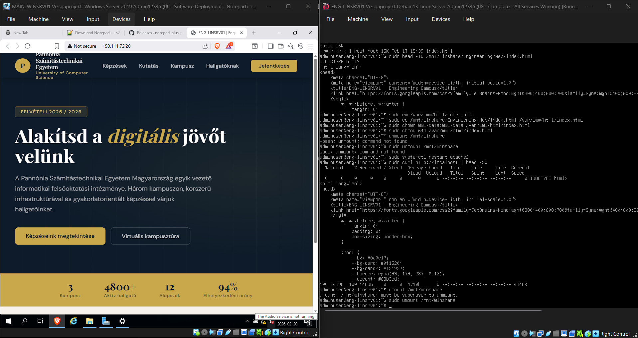
Linux Server – Live Demonstration
Left: ENG-LINSRV01 web page – Apache2 running · Right: terminal – curl test, backup process

Slide 18
Wireless Network & DHCP Configuration
Wireless Access Point
DHCP Relay – ip helper-address
WPA2-PSK encryption on every campus
Campus-specific SSIDs (e.g., MainCampus-WiFi)
VLAN 50 (Guest): internet-only, internal network access denied
2.4 GHz / 5 GHz dual-band
DHCP broadcasts propagate only within their own segment.
The server would be unreachable from different VLANs.
Solution: ip helper-address on the SVI interfaces.
→ Requests forwarded to MAIN-WINSRV01.
DHCP Scopes
DHCP Snooping
VLAN 10 Students: 150.111.64.0/22 (~1000 host)
VLAN 20 Faculty: 150.111.68.0/23 (~500 host)
VLAN 50 Wireless: /26 (~60 host)
Reservation: Fixed IP for servers based on MAC address
Prevents rogue DHCP servers on the network.
Trusted port: only the uplink can issue IP addresses.
Untrusted: access ports – DHCP offers are blocked.
Binding table: Port↔MAC↔IP mapping.

Slide 19
Testing and Results
100+
5
10
100%
test cases
areas
failures
pass
executed
covered
fixed
final result
VLAN configuration
Segmentation and trunk port verification – show vlan brief
IPv4 & IPv6 DHCP
IP assignment in every VLAN – ping + ipconfig test
OSPF routing
Neighbor adjacency, route table consistency – show ip route
Security & ACL
Verifying blocked traffic is actually blocked – show ip access-lists
Wireless connectivity
SSID visibility, WPA2 authentication, IP assignment

Slide 20
Testing Methodology
Test Catalog – Excel
Typical Failures and Fixes
100+ rows: Test ID, Description, Expected, Actual, Status
Statuses: PASS / FAIL / SKIP
Categories: Connectivity · VLAN · DHCP · OSPF · Security · Wireless
Verification: Packet Tracer simulation + IOS show commands
Jira: every FAIL logged as an open ticket
Error 1: OSPF neighbor failed to form → timer mismatch fixed
Error 2: DHCP scope assignment error → ip helper-address was missing
Error 3: VLAN trunk blocking traffic → allowed VLAN list updated
Every failure documented in Jira, re-test performed
Final result: all 10 failures brought to PASS status

Slide 21
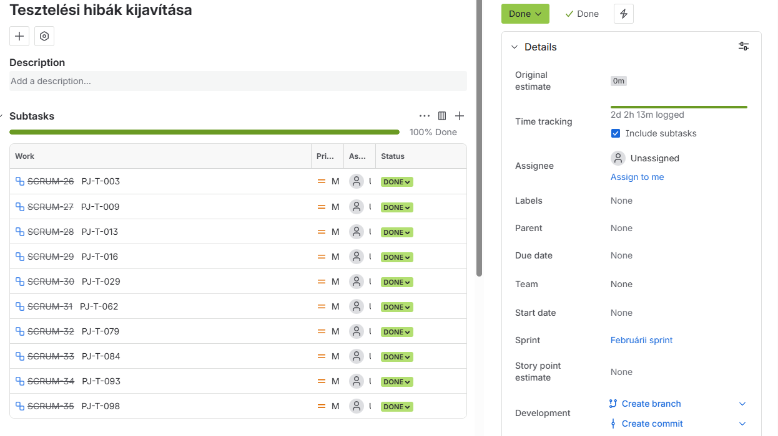
Jira – Issue Tracking & Project Management
February sprint · 10 bug fixes · 100% DONE · 2d 2h 13m logged work time

Slide 22
Teamwork & Tools
Jira
Git
Discord
Sprint planning, backlog management
Pie chart – task statuses
Team metrics, incident ticket management
Version control – every change is tracked
Branch structure, commit history
Documentation and configuration files
Daily communication, quick sync-ups
File sharing and decision log
Intra-team coordination

Slide 23
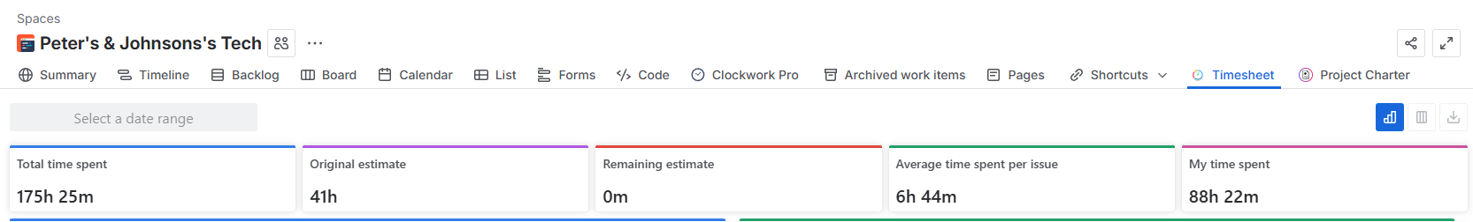
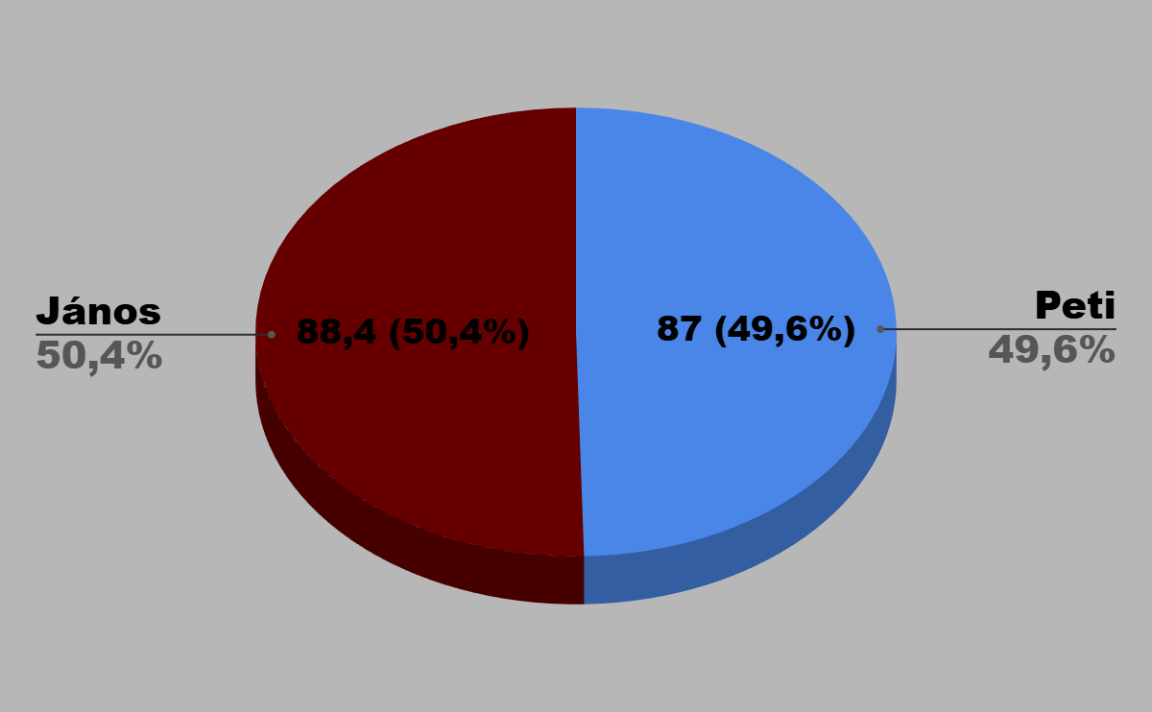
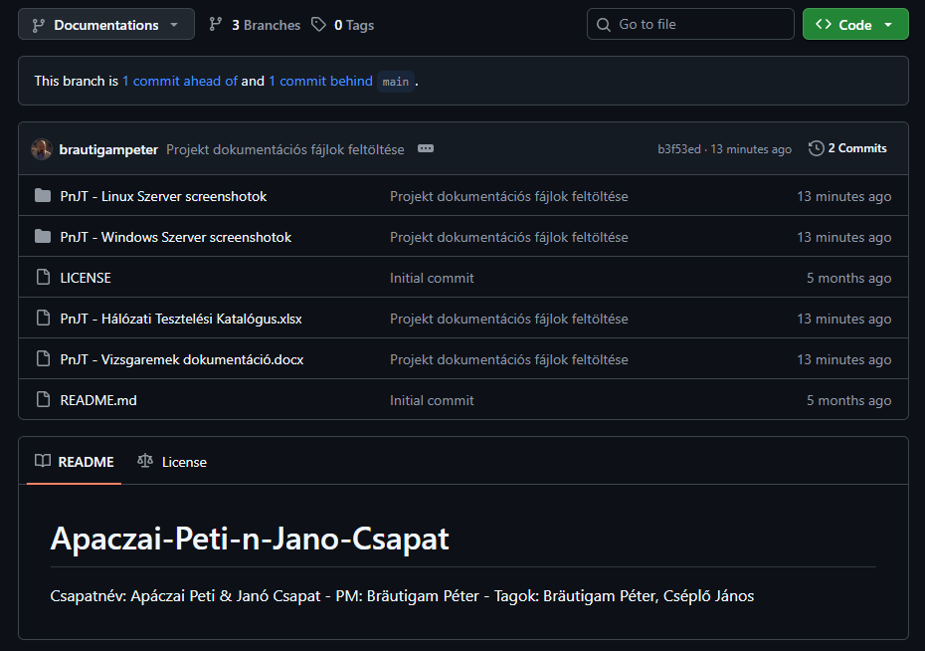
JIRA/GIT
Sprint planning, backlog management,
pie chart, task statuses, team metrics, version control

Slide 24
Summary
Project Results:
Three-Campus network with full-mesh topology – no single point of failure
IPv4/IPv6 dual-stack implementation – 150.111.x.x + 2001:ABCD:E0::/48
7 services running: AD · DNS · DHCP · File · Print · Web · Backup
Multi-layer redundancy: EtherChannel (L2) + OSPF auto-rerouting (L3)
Comprehensive security: ASA · NAT/PAT · ACL · IPsec VPN · WPA2
Wireless integration on every campus – WPA2-PSK, VLAN segmented
Peter's & Johnson's Tech · Bräutigam Péter · Cséplő János | Dombóvár, 2026
Thank you for your attention — we are happy to answer any questions

